Slide 1
Big Data Analytics
Your Company Name

Slide 2

Media is the most popular source of big data, as it provides valuable insights on consumer preferences & changing trends
Media includes social media and interactive platforms, like Google, Facebook, Twitter, YouTube, Instagram
Media
Generic media like images, videos, audios, and podcasts that provide quantitative and qualitative insights on every aspect of user interaction

Slide 3
Cloud
In this era, companies have moved ahead of traditional data sources by shifting their data on the cloud
Text Here
Cloud storage accommodates structured & unstructured data & provides business with real-time information & on-demand insights
The main attribute of cloud computing is its flexibility & scalability

Slide 4

The public web constitutes big data that is widespread & easily accessible.
Data on the Web or ‘Internet’ is commonly available to individuals & companies alike. Moreover, web services such as Wikipedia provide free & quick informational insights to everyone
Web
The enormity of the Web ensures for its diverse usability
This slide is 100% editable. Adapt it to your needs and capture your audience's attention.

Slide 5
Internet of Things
IoT is now gaining momentum and includes big data generated, not only from computers and smartphones, but also possibly from every device that can emit data
This data is usually generated from the sensors that are connected to electronic devices
Internet of
Things
Machine-generated content or data created from IoT constitute a valuable source of big data
This slide is 100% editable. Adapt it to your needs and capture your audience's attention.

Slide 6
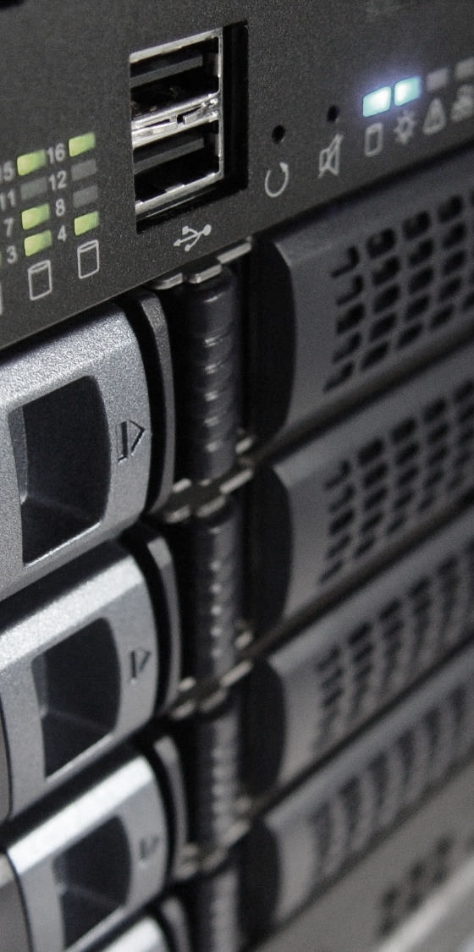
Businesses today prefer to use an amalgamation of traditional & modern databases to acquire relevant big data
This integration paves the way for a hybrid data model and requires low investment and IT infrastructural costs.
Database
These databases can then provide for the extraction of insights that are used to drive business profits.
Popular databases include a variety of data sources, such as MS Access, DB2, Oracle, SQL, & Amazon Simple, among others.
This slide is 100% editable. Adapt it to your needs and capture your audience's attention.

Slide 7
Social Network Profiles
Tapping user profiles from Facebook, LinkedIn, Yahoo, Google, and specific-interest social or travel sites, to cull individuals’ profiles and demographic information, and extend that to capture their hopefully-like-minded networks
This requires a fairly straightforward API integration for importing pre-defined fields and values – for example, a social network API integration that gathers every B2B marketer on Twitter
This slide is 100% editable. Adapt it to your needs and capture your audience's attention.

Slide 8
Yelp-style Catalog
Review Sites
Other review-centric sites like Apple’s App Store, Amazon, ZDNet, etc
Social Influencers
This slide is 100% editable. Adapt it to your needs and capture your audience's attention.
Twitter & Facebook “likes,”
User Forums
Blog Comments
Editor Posts
Analyst Reports
Subject-matter Experts

Slide 9
Activity – Generated Data
Computer and mobile device log files i.e. “The Internet of Things.”
This category includes web site tracking information, application logs, and sensor data – such as check-ins and other location tracking – among other machine-generated content
The data generated by the processors found within vehicles, video games, cable boxes or, soon, household appliances
This slide is 100% editable. Adapt it to your needs and capture your audience's attention.

Slide 10

Data Warehouse Appliances
Teradata, IBM Netezza, EMC Greenplum, etc. are collecting from operational systems the internal, transactional data that is already prepared for analysis
These will likely become an integration target that will assist in enhancing the parsed and reduced results from your Big Data installation

Slide 11
Big Data Sources
Network and in-stream monitoring technologies
Data warehouse appliances
Activity
Generated Data
Social Influencers
Social
Network Profiles
Databases
Big Data Sources
Legacy Documents
Media
Cloud
Web
Internet
of Things
This slide is 100% editable. Adapt it to your needs and capture your audience's attention.

Slide 12

Packet Evaluation
Network and in - Stream Monitoring Technologies
Distributed Query Processing-like Applications
Email Parsers
This slide is 100% editable. Adapt it to your needs and capture your audience's attention.

Slide 13
Legacy Documents
There are still multiple untapped resources. Some of them are
Archives of Statements
Insurance
Forms
Medical
Record
Customer Correspondence
This slide is 100% editable. Adapt it to your needs and capture your audience's attention.

Slide 14
Big Data Analytics Icons Slide

Slide 15
Additional Slides

Slide 16
Column Chart
98%
Product
01
This graph/chart is linked to excel, and changes automatically based on data. Just left click on it and select “Edit Data”.
Product
02
This graph/chart is linked to excel, and changes automatically based on data. Just left click on it and select “Edit Data”.

Slide 17



Our Awesome Team
Rosy Anderson
Tom Disouza
Alisha Max
CEO & Founder
Financial Advisor
Web Designer
This slide is 100% editable. Adapt it to your needs and capture your audience's attention.
This slide is 100% editable. Adapt it to your needs and capture your audience's attention.
This slide is 100% editable. Adapt it to your needs and capture your audience's attention.

Slide 18

Professional
This slide is 100% editable. Adapt it to your needs and capture your audience's attention.
Creative
This slide is 100% editable. Adapt it to your needs and capture your audience's attention.
Talented
This slide is 100% editable. Adapt it to your needs and capture your audience's attention.
About Us

Slide 19
Idea Generation
01
This slide is 100% editable. Adapt it to your needs and capture your audience's attention.
02
This slide is 100% editable. Adapt it to your needs and capture your audience's attention.
03
This slide is 100% editable. Adapt it to your needs and capture your audience's attention.

Slide 20

Address
# street number, city, state
Contact Number
0123456789
Email Address
emailaddress123@gmail.com
Thank You

